Slide 1



Smart home automation using Google assistant and NodeMCU
Dandla Saikumar
IBM Certified DS&AI Professional, Software Engineer
Infor India

Slide 2
CONTENTS:
Introduction
Benefits of project
Circuit Diagram
Hardware Components
System/Software Components
Flow Chart
Connecting Blynk App
Configuring IFTTT for triggering Webservices
Implementation
Result
Future Works
Useful Websites

Slide 3
Introduction:
Google assistant-controlled Home automation is to control home devices with voice.
Blynk App which is a cloud based free IoT web server used to create virtual switches, is linking to IFTTT website.
The commands given through the Google assistant are decoded and then sent to the microcontroller, the microcontroller in turn control the relays connected to it. The device connected to the respective relay can be turned On or OFF as per the users request to the Google Assistant.
The microcontroller used is NodeMCU (ESP8266) and the communication between the microcontroller and the application is established via Wi-Fi (Internet).

Slide 4
Benefits of Project:
Savings: Smart thermostats and smart lightbulbs save energy, cutting utility costs over time.
Safety: Many home automation technologies fall under the umbrella of home security.
Convenience: Because home automation technology performs rote tasks automatically, end users experience great convenience.
Control: Consumers also choose smart home devices to better control functions within the home.
Comfort: Some people use smart technology to record shows or to play music throughout the home. Connected devices can also help create a comfortable atmosphere—they provide intelligent and adaptive lighting, sound, and temperature, which can all help create an inviting environment.
Peace of Mind: Finally, many consumers invest in home automation technology for peace of mind.

Slide 5
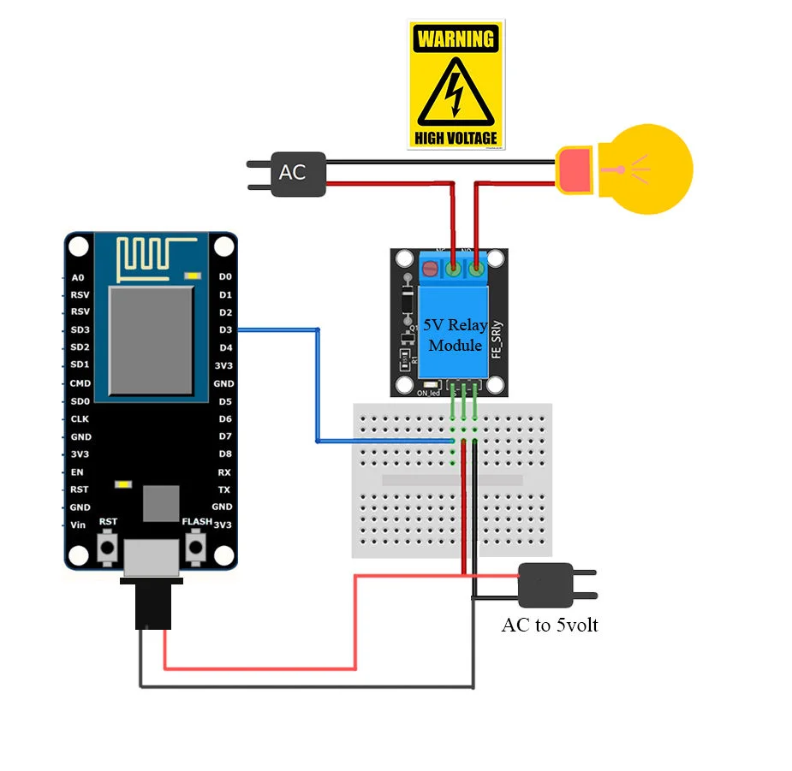
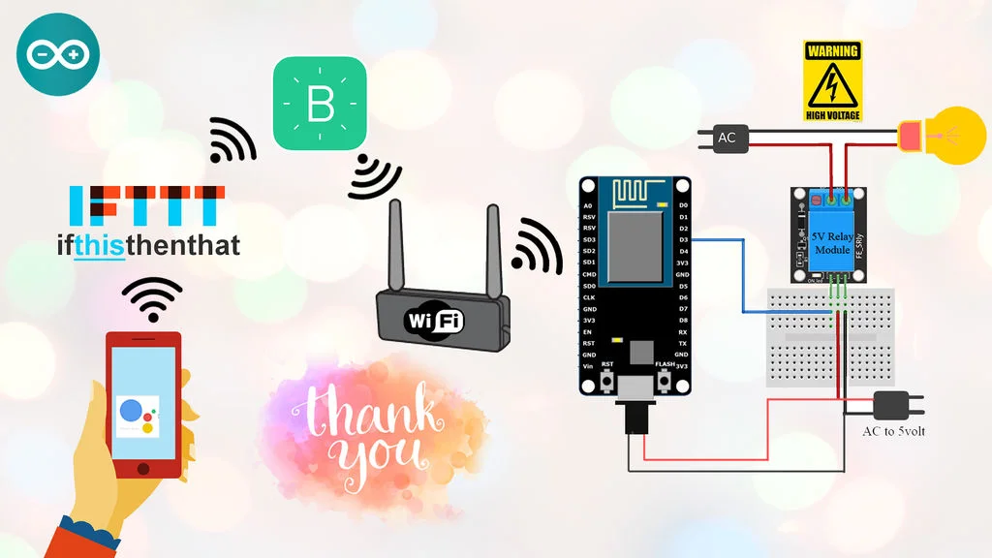
Circuit Diagram

Slide 6
Hardware Components
NodeMCU – 32-bit ESP8266 development board with Wi-Fi SoC.
Relay module
One 15W Bulb
One 9V DC Fan

Slide 7
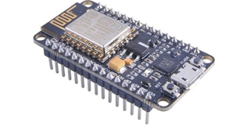
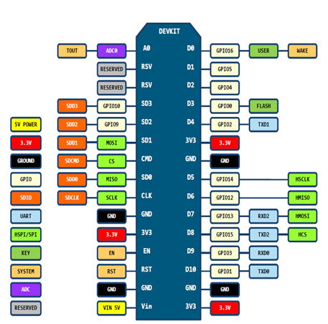
NODE MCU (ESP8266)
NodeMCU is an open source IoT platform, includes firmware which runs on the ESP8266 Wi-Fi Module from Espressif Systems, and hardware which is based on the ESP-12 module.
Interactive
Programmable
Low cost
WI-FI enabled
USB-TTL included
Plug & Play

Slide 8
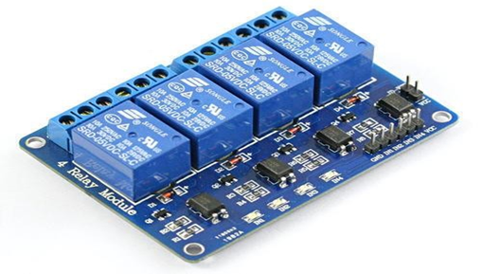
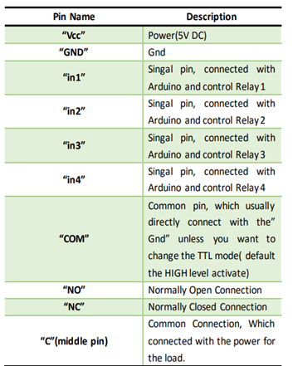
RELAY MODULE
4-Channel Relay interface board, and each one needs 15-20mA Driver Current
Both controlled by 12V and 5V input Voltage
Equipped with high-current relay, AC250V 10A; DC30V 10A
Standard interface that can be controlled directly by microcontroller.
Opto-isolated inputs
Indication LED’s for Relay output status.

Slide 9
System/Software Components
Google assistant application
Blynk App
IFTTT Service
Arduino IDE

Slide 10
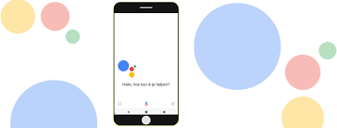
GOOGLE ASSISTANT
The Google Assistant is an Artificial Intelligence based Virtual assistant software which allows its users to control all the apps in their device.
It allows the users to control and command most of the apps in their devices using voice commands.
This provides more convenience to the people as they only have to command the google assistant thorough voice command.

Slide 11
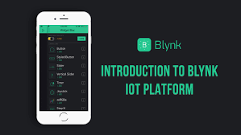
BLYNK APP
Blynk is a hardware-agnostic IoT platform with white-label mobile apps, private clouds, device management, data analytics, and machine learning.
IoT platform to connect your devices to the cloud, design apps to control them, analyze telemetry data, and manage your deployed products at scale.
Visualize sensor data, control your equipment remotely, set notifications and rules, manage multiple devices and more.

Slide 12
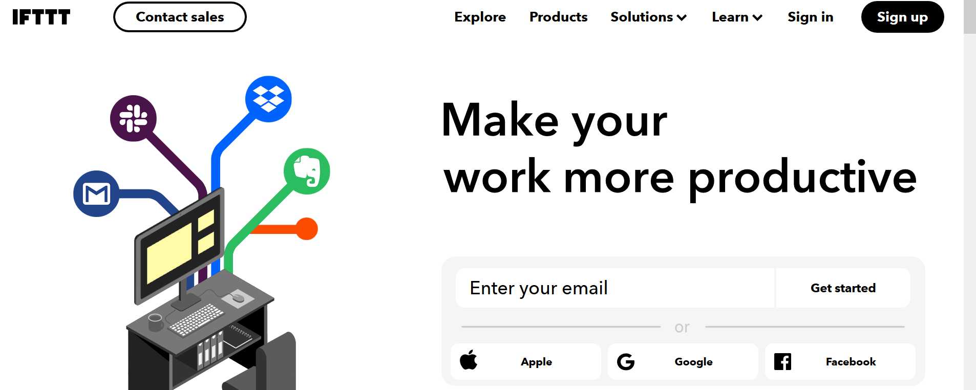
IFTTT Service
If This Then That, also known as IFTTT, is a free web-based service to create chains of simple conditional statements, called applets.
An applet is triggered by changes that occur within other web services such as Gmail, Facebook, Telegram, Instagram, or Pinterest.
IFTTT is the free way to get all your apps and devices talking to each other. Not everything on the internet plays nice, so we're on a mission to build a more connected world.

Slide 13
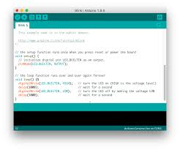
Arduino IDE
The Arduino Integrated Development Environment (IDE) is a cross-platform application (for Windows, macOS, Linux) that is written in functions from C and C++.
It is used to write and upload programs to Arduino compatible boards, but also, with the help of 3rd party cores, other vendor development boards.
The Arduino IDE supplies a software library from the Wiring project, which provides many common input and output procedures.

Slide 14
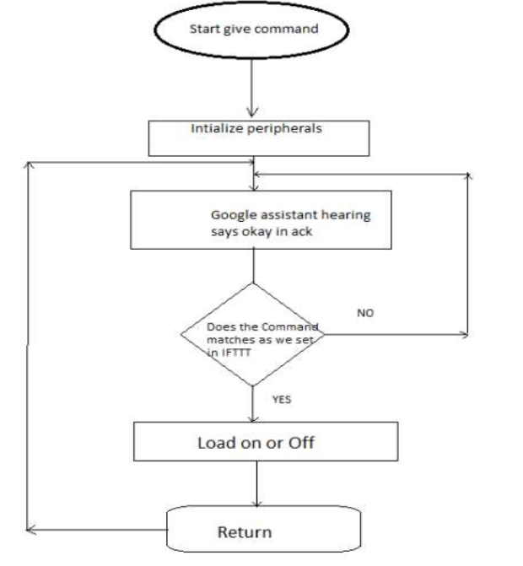
Flow Chart

Slide 15
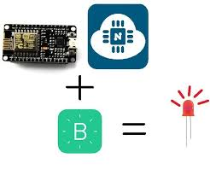
Connecting Blynk App

Slide 16

Configuring IFTTT for triggering Webservices:

Slide 17
Implementation
#define BLYNK_PRINT Serial
#include <ESP8266WiFi. h>
char auth [ ] = "tJkoRhpp51-4MEVRUAng6vEC7J4ia0W9"; // auth token from Blynk app.
char ssid[ ] = "Your network name";
char pass[ ] = "Your network password";
void setup( )
{
Serial. begin(9600);
digitalWrite(D0, HIGH);
digitalWrite(D1, HIGH);
Blynk.begin(auth, ssid, pass);
}
void loop( )
{
Blynk.run ( );
}

Slide 18
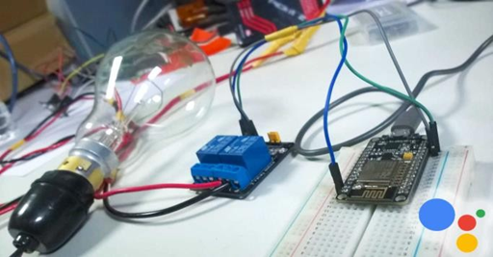
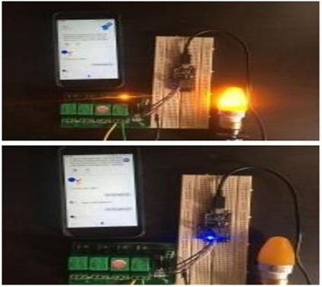
Result

Slide 19
FUTURE WORK
variety of enhancements that could be made to this system to achieve greater accuracy in sensing and detection.
There are a lot of other sensors that can be used to increase the security and control of the home like pressure sensor that can be put outside the home to detect that someone will enter the home.
Changing the way of the automated notifications by using the GSM module to make this system more professional.
A smart garage that can measure the length of the car and choose which block to put the car into it and it will navigate the car through the garage to make the parking easy for the homeowner in his garage

Slide 20
USEFUL WEBSITES
https://ifttt.com/discover
https://www.pocketlini.com/SmartHome/ SmartHomenew
https://nodemcu.readthedocs.io/en/master
https://iobytes.wordpress.com/nodemcuin out/
https://assistant.google.com/intl/en_in/
https://www.arduino.cc/en/Guide/Environ ment

Slide 21
Thank You

